Slide 1


Slide 2


Q1111111111111111`
Cervical Cancer Risk Classification
Raghav

Slide 3
Introduction
Cervical cancer is a type of cancer that occurs in the cell of the cervix.
Cervical cancer is the fourth most common cancer in women globally with an estimated 604 000 new cases and 342 000 deaths in 2020.
Cervical cancer is caused by persistent infection with the human papillomavirus (HPV). Women living with HIV are 6 times more likely to develop cervical cancer compared to women without HIV.

Slide 4
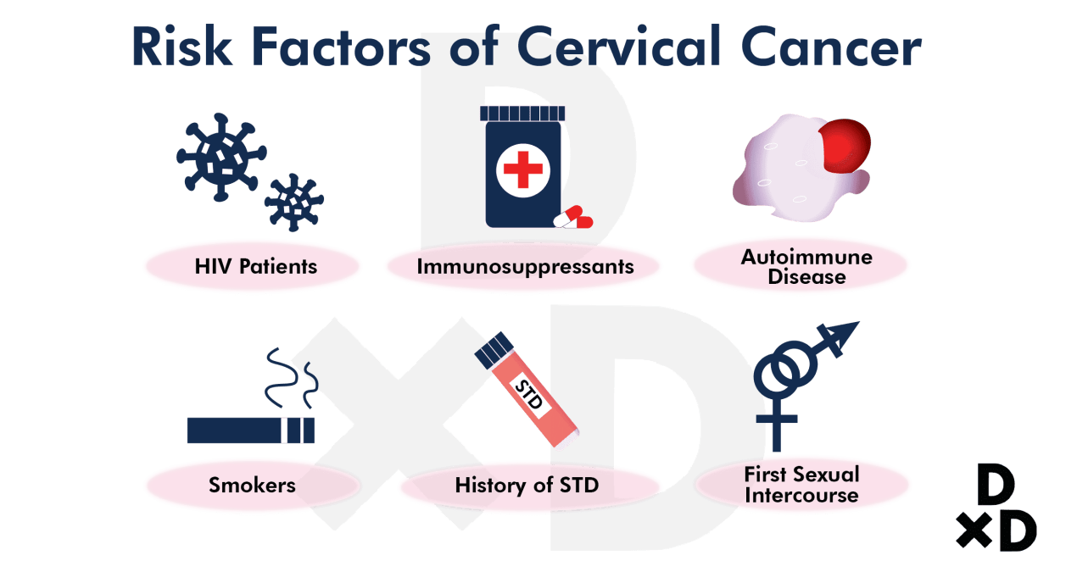
Thank You!!

Slide 5
About Data Set
In this project we have used Cervical Cancer Datasets is Obtained from UCI Repository
The Datasets comprises demographic information, & historic medical records of 858 patients.
Several patients decided not to answer some of the question because of privacy concerns(values=?)
The datasets has been target variables:
Hinselmann
Schiller
Cytology
biopsy

Slide 6
Exploratory Data Analysis
858
Data points
36
Features
Binary outcome

Slide 7
Methodology
Question: Can we accurately predict cancer based on risk factors?
Balancing the Data: Oversampling, Under sampling, SMOTE*
Classification via Logistic Regression
Grid Search for Optimizing the Model
Testing Model by Confusion Matrix
*Synthetic Minority Oversampling Technique

Slide 8
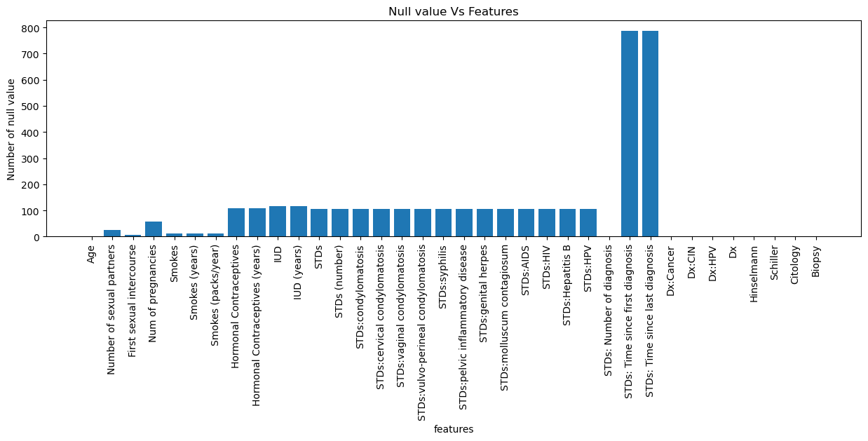
Several patients decided not to answer some of the question because of privacy concerns(values=?)
replace original data frame's ? symbol with nulls
too many null values in 2 columns i.e. "STDs: Time since first diagnosis" and "STDs: Time since last diagnosis"

Slide 9
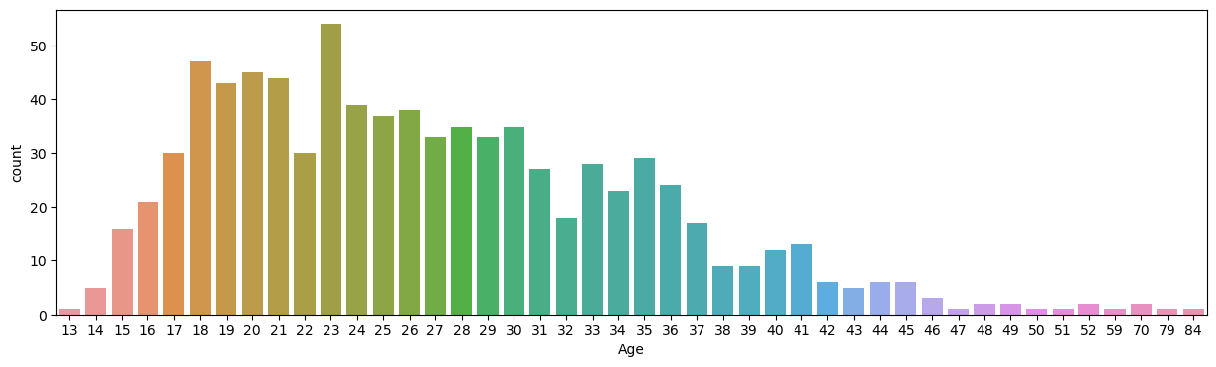
Age of the women facing the risk:
The minimum age of the women developing the risk of cervical cancer is 26.
Distribution of ages is as shown below

Slide 10
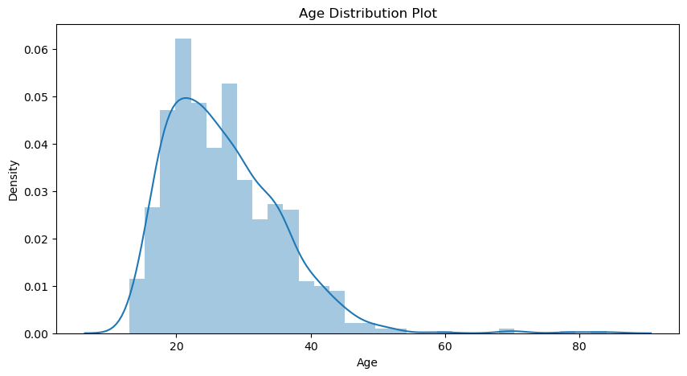
The density plot against the Age and the test indicate that the women with the age in range of 20 to 35 have the highest chances of developing the risk of cervical cancer. The peaks at age of 50 and the further extension of the density plot indicate that some of the women face the risk of cervical cancer even at that age.

Slide 11
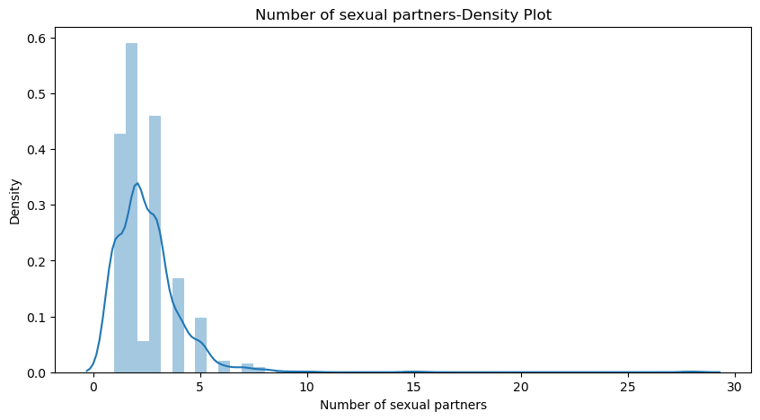
Age and Number of sexual partners
As age of women increases, the number of sexual partners might increase which in turn increases the possibility of facing the risk. Even the resources here: https://www.mayoclinic.org/diseases-conditions/cervical-cancer/symptoms-causes/syc-20352501 supports this statement. From the below we can see that the women at the age of 30 to 35 having the number of sexual partners of 4 or 5 is having the higher risk of developing cervical cancer.

Slide 12
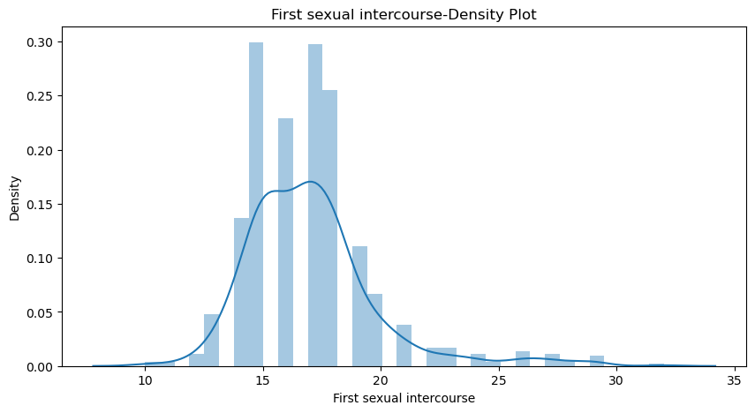
First Sexual intercourse
Mean age of the women whose first sexual intercourse is 16. The plot below gives an intuition that most of the women started first sexual intercourse between the age 15 to 20.

Slide 13
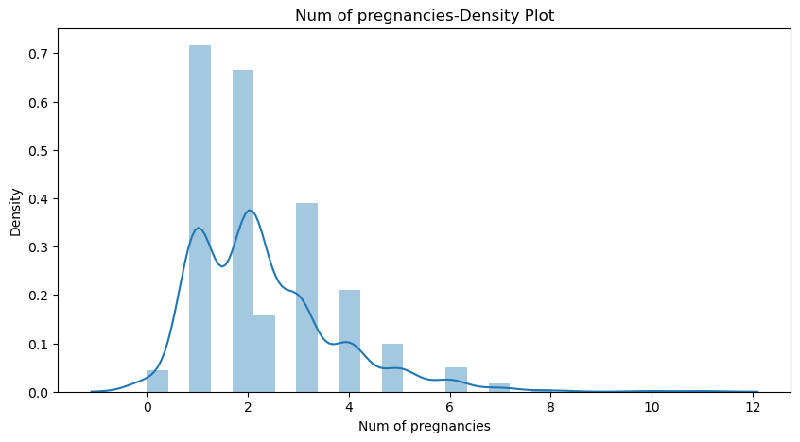
Number of Pregnancies
Data is analyzed against the number of pregnancies and the number of sexual partners. It is found that 4% of the women having number of sexual partners greater than 2 with number of pregnancies greater than 3 are facing the risk of cancer. The below is the chart for number of women facing the risk.

Slide 14
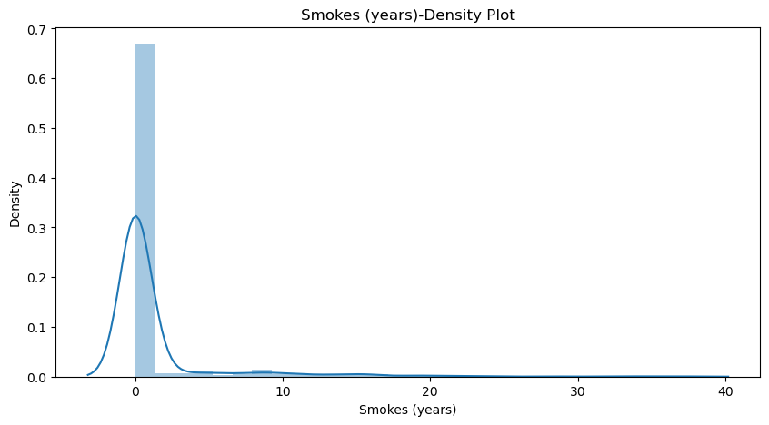
Risk for Women Who Smokes
8% of women are smoking for more than 5 years and among them 16 % are the developing the risk of facing the cancer. The tests like schiller and biopsy can detect these types of factors causing cancer. The studies like https://www.mayoclinic.org/diseases-conditions/cervical-cancer/symptoms-causes/syc-20352501 shows that smoking is one the key risk factor of developing cervical cancer.

Slide 15
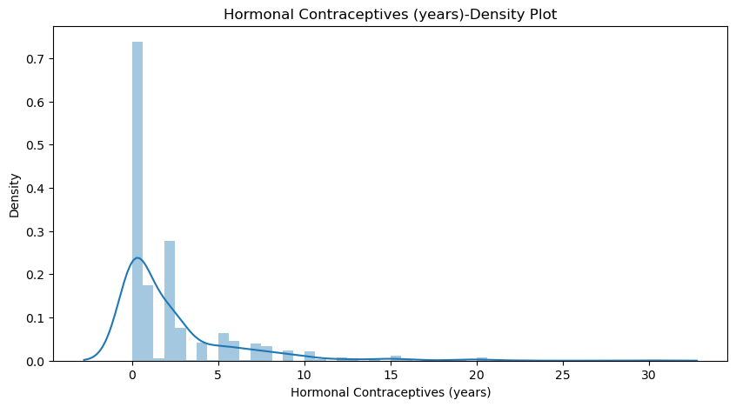
Women using Hormonal Contraceptives
Many of the women reported that they are using the Hormonal contraceptives from minimum of 0 to 30 years. Women who have taken the hormonal contraceptives for more than five years have the higher risk of cervical cancer. The small peaks at the age 10 & 15 and also more than 15 shows even higher risk than women who have not used the contraceptives.

Slide 16
Final statistics of Cervical Cancer Dataset:
Mean age of the women facing the risk of cancer is 26. Women in age groups of 20 to 35 have the higher risk of developing the risk.
As the number of sexual partners increase, the chances of developing the risk of cancer are higher.
Women started the early sexual activity between the age of 15 to 20 have the higher chances of facing the risk of cancer. Mean of the women with the first sexual activity is 16.
Women who have full term pregnancies greater than three have the higher risk of getting the cancer.
16% of the women who are smoking for more than 5 years are facing the problem of cervical cancer.
18% of the women stated that they are using hormonal contraceptives. Women using hormonal contraceptives for more than 5 years are having the higher probability of getting the cancer.
8% of the women who used hormonal contraceptives are facing the problem of cervical cancer while 5% of women who used IUD are having the problem of cervical cancer.

Slide 17
Model building

Slide 18
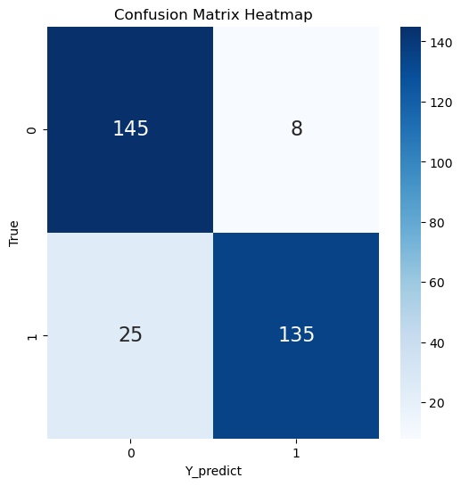
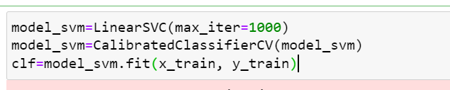
Model- Support Vector Machines (SVM)
Import necessary libraries (train_test_split for data splitting, SVC for SVM implementation, and accuracy_score for model evaluation).
Consider only two classes (indices 0 and 1) for binary classification from the Iris dataset.
Split the data into training and testing sets using train_test_split.
Train the SVM classifier on the training data using fit
Make predictions on the testing set using predict.

Slide 19
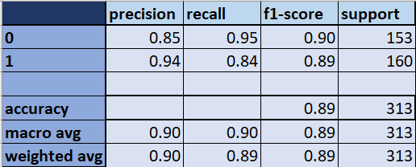
The provided classification report demonstrates the performance metrics of a binary classification model evaluated on a test dataset with 313 samples.
Summary:
The model demonstrates reasonably good performance but may have some imbalances in predicting positive and negative classes.
Precision and recall for both classes are relatively balanced, but there is a noticeable trade-off between precision and recall for Class 1.
The F1-Scores for both classes are close to each other, indicating a reasonable balance between precision and recall for both positive and negative classes.
The accuracy of 89% indicates the overall correctness of the model's predictions.
This analysis suggests that the model performs fairly well, but there might be a slight bias towards precision for Class 1 at the expense of recall. Further tuning or adjustments could focus on achieving a better balance between precision and recall for both classes to enhance the model's performance.
SVM model Accuracy: 89.46%

Slide 20

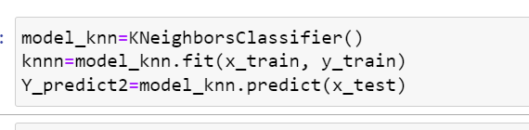
Model- K-Nearest Neighbors (KNN)
Import necessary libraries (train_test_split for data splitting, KNeighborsClassifier for KNN implementation, and accuracy_score for model evaluation).
Split the data into training and testing sets using train_test_split.
Train the KNN classifier on the training data using fit.
Make predictions on the testing set using predict.

Slide 21
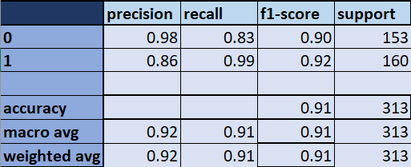
The provided classification report demonstrates the performance metrics of a binary classification model evaluated on a test dataset with 313 samples.
Summary:
The model performs relatively well, especially in correctly identifying positive cases (Class 1), as evidenced by high precision, recall, and F1-score for this class.
However, there's a slightly lower recall for negative cases (Class 0), indicating a relatively higher false-negative rate for negative predictions.
The overall accuracy of 91% suggests that the model makes accurate predictions for both classes combined.
This analysis implies that while the model has commendable performance, there might be a need to focus on improving recall for the negative class to reduce false negatives in predictions for negative instances.
KNN model Accuracy: 91.05%

Slide 22
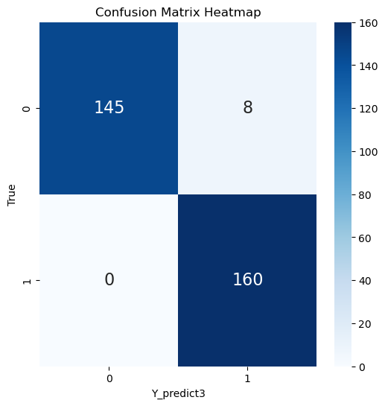
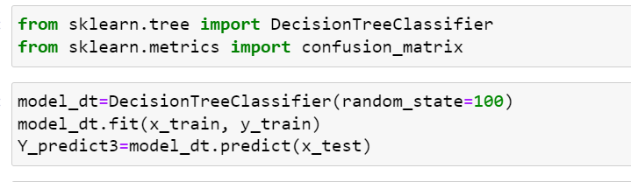
Model- Decision Tree
Import necessary libraries (train_test_split for data splitting, DecisionTreeClassifier for decision tree implementation, and accuracy score, classification report for model evaluation).
Split the data into training and testing sets using train_test_split.
Create a Decision Tree classifier with default parameters.
Train the Decision Tree classifier on the training data using fit.
Make predictions on the testing set using predict.
Calculate the accuracy of the model using the ground truth labels and the predicted labels.
Display the classification report, which includes precision, recall, F1-score, and other metrics for each class.

Slide 23
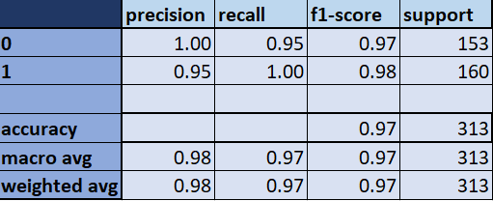
The provided classification report demonstrates the performance metrics of a binary classification model evaluated on a test dataset with 313 samples.
Summary:
The model demonstrates exceptional performance with high precision, recall, and F1-scores for both positive and negative classes.
Class 0 (negative cases) achieved perfect precision, meaning there were no false positive predictions for this class.
Class 1 (positive cases) shows high precision and recall, indicating accurate predictions and no false negative instances.
The overall accuracy of 97% suggests that the model makes accurate predictions for both classes combined.
This analysis indicates that the model performs exceptionally well, with virtually perfect precision and recall for negative and positive classes, respectively, resulting in high overall accuracy.
Decision tree model Accuracy: 97.44%

Slide 24

Model Performance
The provided table displays the accuracy scores achieved by three different machine learning models: Support Vector Machine (SVM), K-Nearest Neighbors (KNN), and Decision Tree (DT)

Slide 25
Decision Tree (DT): 97.44% Accuracy
The Decision Tree model exhibits the highest accuracy among the three models.
This high accuracy suggests that the Decision Tree algorithm performed exceptionally well on the given dataset.
The model seems to have effectively learned and generalized patterns from the data, resulting in accurate predictions.
K-Nearest Neighbors (KNN): 91.05% Accuracy
The KNN model shows a good accuracy score but is slightly lower than the Decision Tree.
KNN typically works well in various scenarios but might require careful tuning of hyperparameters for optimal performance.
Support Vector Machine (SVM): 88.82% Accuracy
SVM achieved the lowest accuracy score among the three models.
While SVM is a powerful algorithm, its performance might be affected by the chosen kernel, parameters, or dataset characteristics.

Slide 26
Summary:
The Decision Tree model outperformed both KNN and SVM in terms of accuracy.
KNN and SVM, although slightly behind, still achieved respectable accuracies.
It's crucial to not only consider accuracy but also evaluate other metrics and conduct further analysis to understand the models' behavior and potential overfitting or underfitting issues.
These accuracy scores provide an initial understanding of model performance, but a comprehensive evaluation considering other metrics (such as precision, recall, F1-score) and potential cross-validation could offer a more holistic assessment of the models' effectiveness

Slide 27
Prevention
Boosting public awareness, access to information and services are key to prevention and control across the life course.
Screening from the age of 30 (25 years in women living with HIV) can detect cervical disease, which when treated, also prevents cervical cancer.
Being vaccinated at age 9–14 years is a very effective way to prevent HPV infection, cervical cancer and other HPV-related cancers.
At any age with symptoms or concerns, early detection followed by prompt quality treatment can cure cervical cancer.

Slide 28
Thank You!

